Slide 1
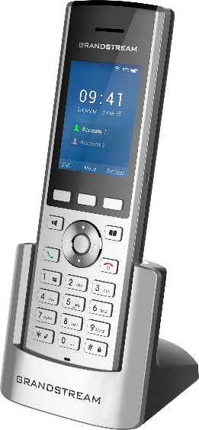
WP800 Cordless WiFi IP Phone – Battle Card
© 2019 Grandstream Networks
A Powerful, Durable WiFi IP Phone for Mobility
Competitive Features
The WP800 was designed for users looking for a portable, durable, WiFi-enabled IP phone that offers the flexibility to move around without restrictions. It gives users immersive dual-band WiFi support, offering tremendous range throughout an office, warehouse, retail store, medical facility, hotel, residence and more. The WP800 also adds Bluetooth support for syncing headsets, a push-to-talk/panic button for instant communication, a rechargeable battery and 1.2 meter drop-safe durability.
 | WP820
WiFi Support | Dual-band 802.11a/b/g/n
Lines/SIP Accounts | 2 lines / 2 SIP accounts
Screen | 2.4 inch (240x320) color LCD
Bluetooth | Yes
Push-to-talk | Yes, customizable
Battery | Rechargeable 1500mAH battery, 7.5 hour talk time, 150 hour standby
Durability | 1.2 meter drop-safe
Dual-band 802.11 a/b/g/n WiFi support
Efficient antenna design
Advanced WiFi roaming support
HD Audio
Supported on both the speakerphone and handset
AEC & noise shield technology to block out background noise
Push-to-talk / Panic - Customizable push-to-talk/panic button
Drop-Safe – 1.2 meter drop safe durability
Bluetooth - Sync Bluetooth headsets & mobile devices (contacts/call transferring) Rechargeable Battery – 1500mAH battery, 7.5 hour talk time, 150 hour standby
Ports – Micro USB for charging and 3.5mm headset jack
Programmable keys – Includes 3 context-sensitive soft keys
Color Screen – Easy-to-use 2.4 inch color LCD display (240x320)

Slide 2
WP800 Cordless WiFi IP Phone – Battle Card
© 2018 Grandstream Networks
 | WP820 | Spectralink 8440 | Unidata Incominc ICW-1000G
WiFi | Dual-band 802.11a/b/g/n | Dual-band 802.11a/b/g/n | Dual-band 802.11a/b/g/n
Lines/SIP Accounts | 2 lines, 2 SIP accounts | 6 line appearances | 1 line / 1 SIP account
Screen | 2.4 inch (240x320) color LCD | 2.2 inch (240x320) color LCD | 2.4 inch (240x32) color LCD
Keys | Backlit keypad, 3 softkeys, dial, hang-up, speakerphone, phonebook, directional pad, volume up/down, push-to-talk/panic button | 4 soft keys, home, back, call, end call keys, directional pad, volume up/down, push-to-talk, panic | Send, end, cancel, directional pad,
Audio | HD audio on the speakerphone and handset | Full-duplex HD audio, no speakerphone | Speakerphone
Voice Codecs | G.711, G.729, G.722, iLBC, Opus, in-band & out-of-band DTMF | G.711, G.729, G.722, G.722.1 | G.711, G.729, DTMF
Bluetooth | Yes | Yes | No
Ports | 3.5mm headset jack, Micro USB (charging) | 2.5mm headset jack, MicroUSB (charging) | 2.5mm headset jack, mini-USB (charging)
Security | MD5 / MD5-sess-based authentication, 256-bit AES secure config file, SRTP, TLS, 802.1x | WEP, WPA-personal, WPA2-Personal, WPA2-Enterprise, 128-bit AES secure config file, SRTP, TLS, 802.1x | WEP 64bits / 128 bits, WPA-PSK / WPA-EAP (WPA and WPA2), 802.1x (EAP-MD5, EAP-TTLS, PEAP, EAP-TLS)
Battery | Rechargeable 1500mAH battery, 7.5 hour talk time, 150 hour standby | Battery and charger purchased separately. Two options: 1) 8 hours talk time, 80 hours standby , 2) 12 hours talk time, 120 hours standby | Rechargeable 1100mAH battery, 14 hours talk time, 150 hours standby
Push-to-Talk | Yes (programmable as push-to-talk, panic, etc.) | Yes | No
Vibration Motor | Yes | Yes | Yes
Durability | Drop-safe from 1.2 meters | Drop-safe, IP-64 Ingress protection | N/A
Provisioning | Upgrade via TFTP/HTTP/HTTPS, TR-069, encrypted XML config file | FTP/TFTP/HTTP/HTTPS, configuration via USB, Spectralink Device Management services | TFTP(default)/HTTP/HTTPS Automatic boot-up provisioning,
Phonebook size | 500 contacts, call log up to 100 calls | 100 contacts, minimum 20 logs | 500 contacts, call log up to 100 calls

